Slide 1

BCA (DATA SCIENCE) VI SEM GROUP PROJECT
DISASTER DETECTION SYSTEM
TEAM MEMBERS:
KARRI SUSANNA
Regd.no: 2021-2222021
P. CH. SRIVATHSA SARMA
Regd.no: 2021-2222028
KANDIPILLI TEJUS
Regd.no: 2021-2222033
ADIGARLA SARATH KUMAR
Regd.no: 2021-2222034
PAMPANA JAIKIRAN
Regd.no: 2021-2222043
Under Guidance of
Smt. U. Sahiti
Assistant Professor
Department of Computer Applications (UG)

Slide 2

Abstract
The "Disaster Detection System" incorporates a crucial image processing process that utilizes advanced machine learning techniques to categorize images, identifying various types of disasters. This component stands at the forefront of disaster monitoring. By improving accuracy and responsiveness in identifying disasters, it aims to provide authorities and organizations with more accurate information.

Slide 3
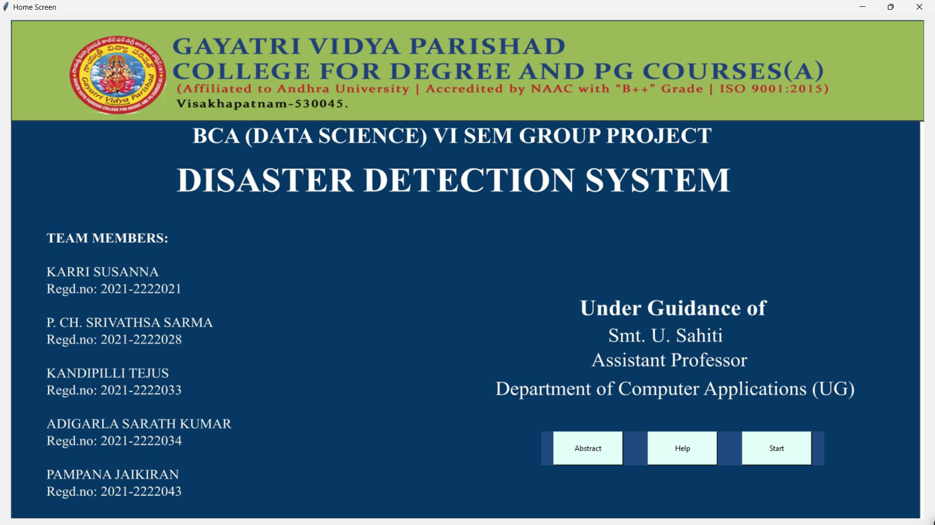

Slide 4
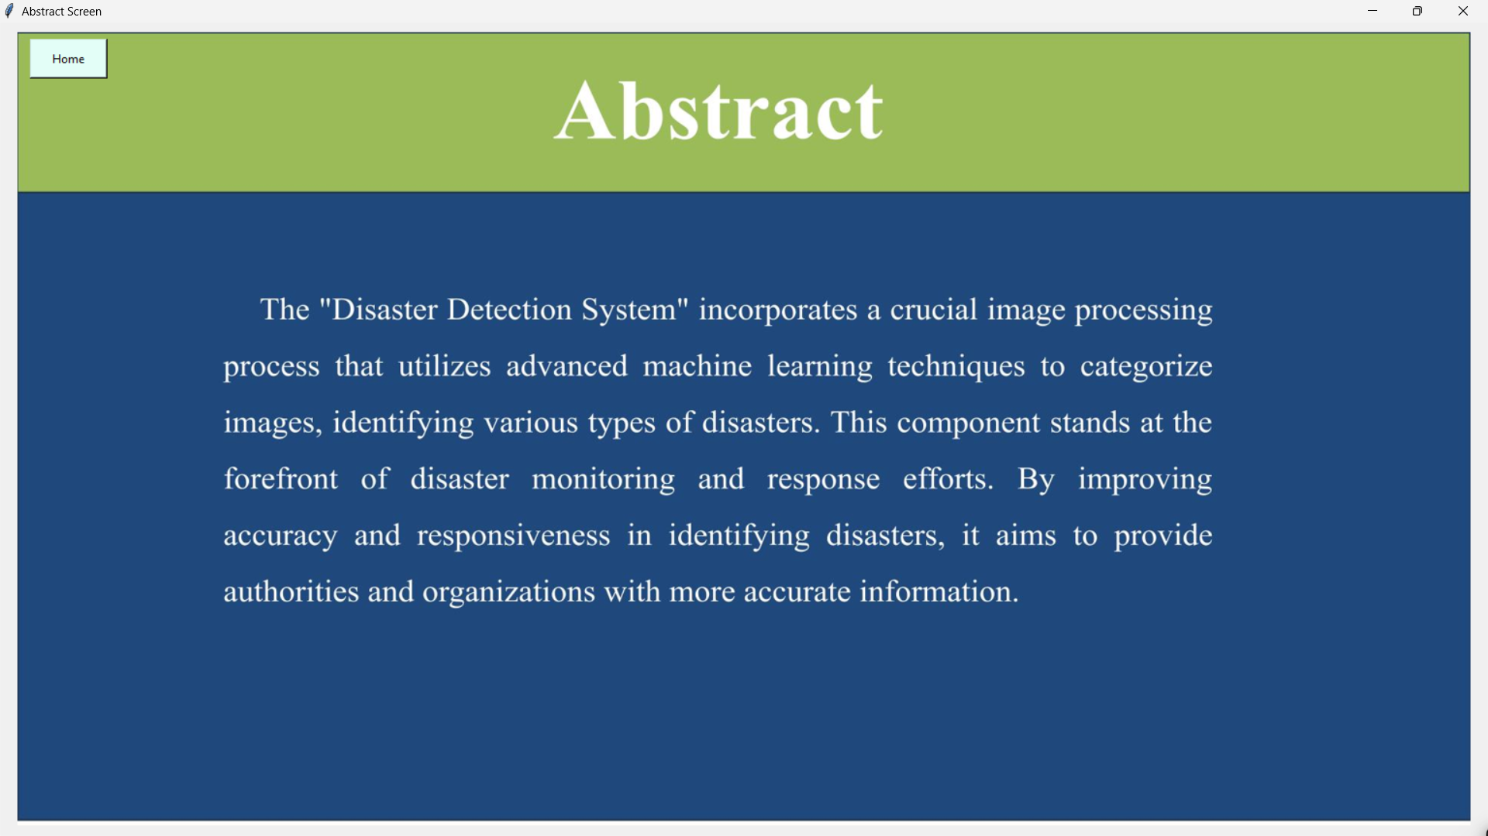

Slide 5
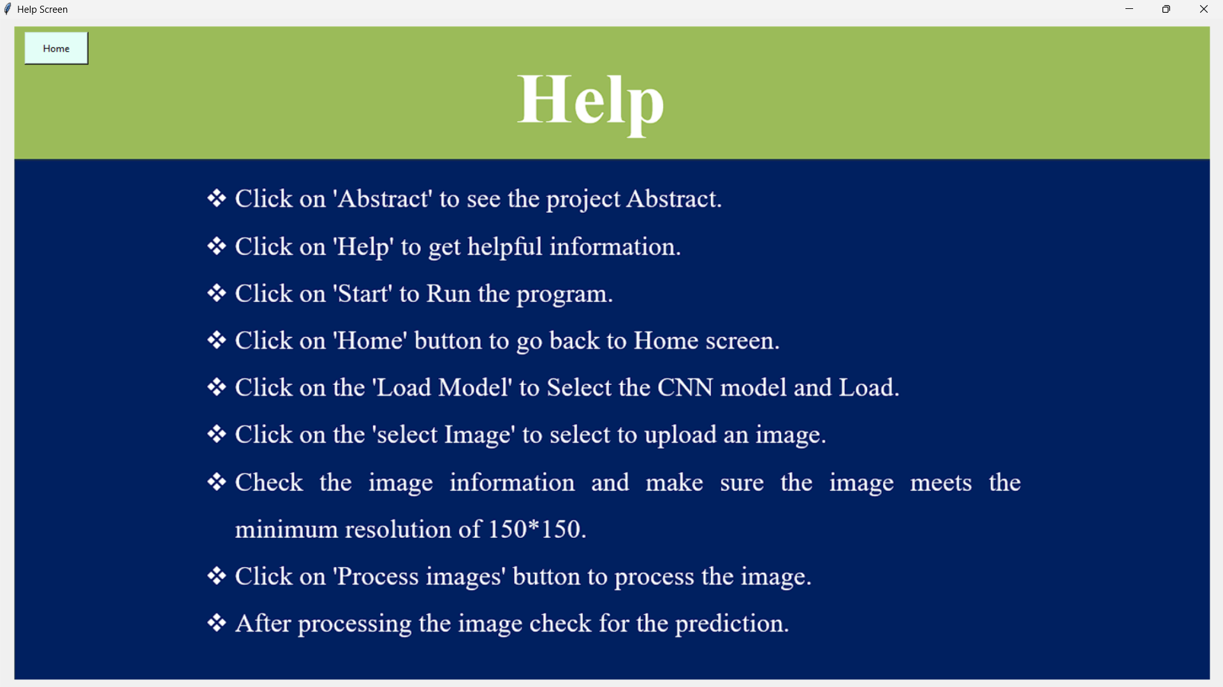

Slide 6
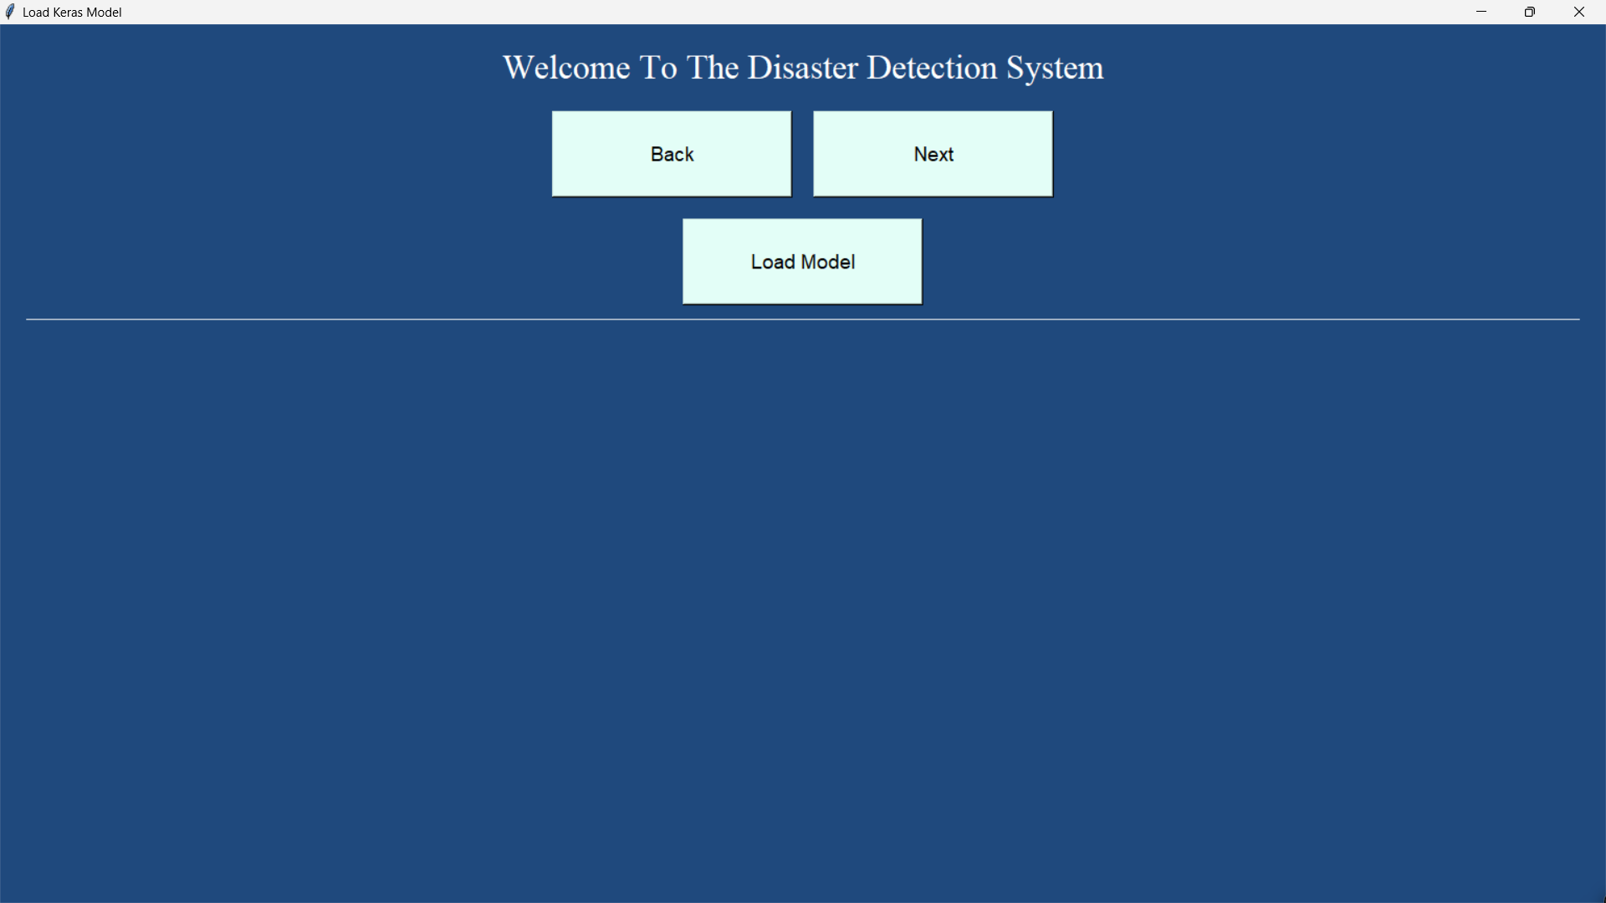

Slide 7


Slide 8
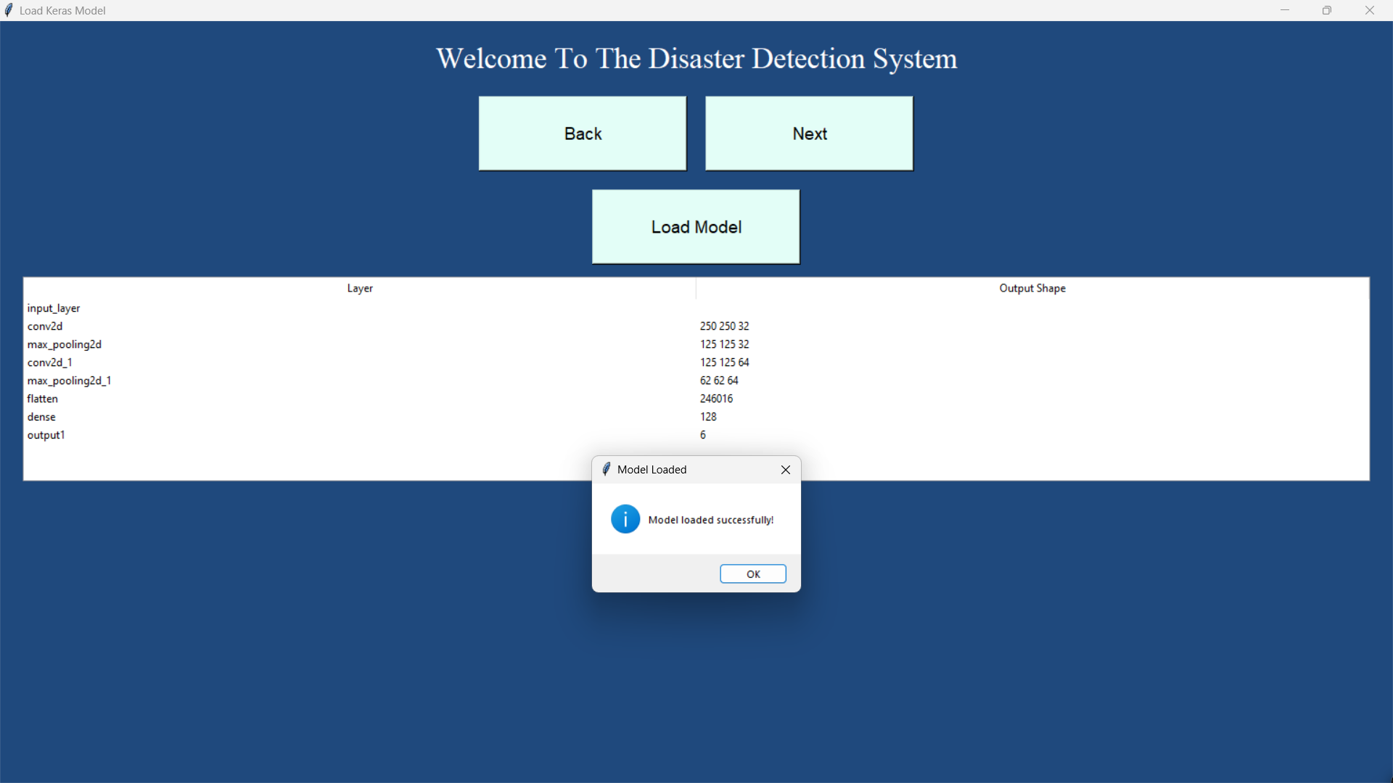

Slide 9
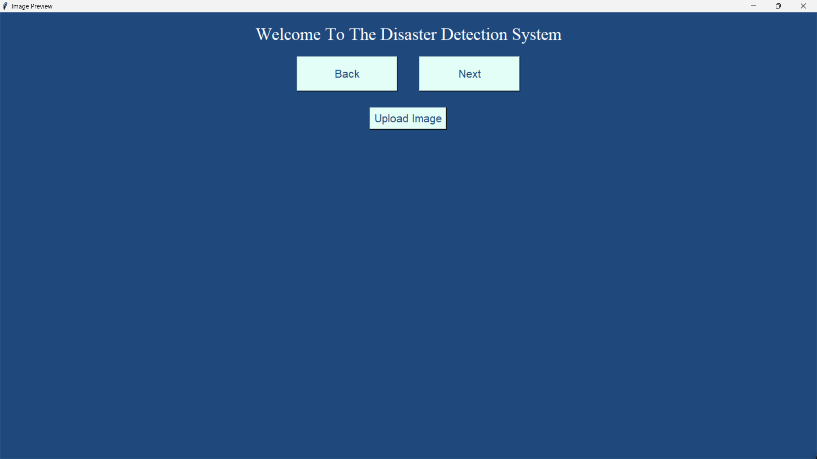

Slide 10


Slide 11
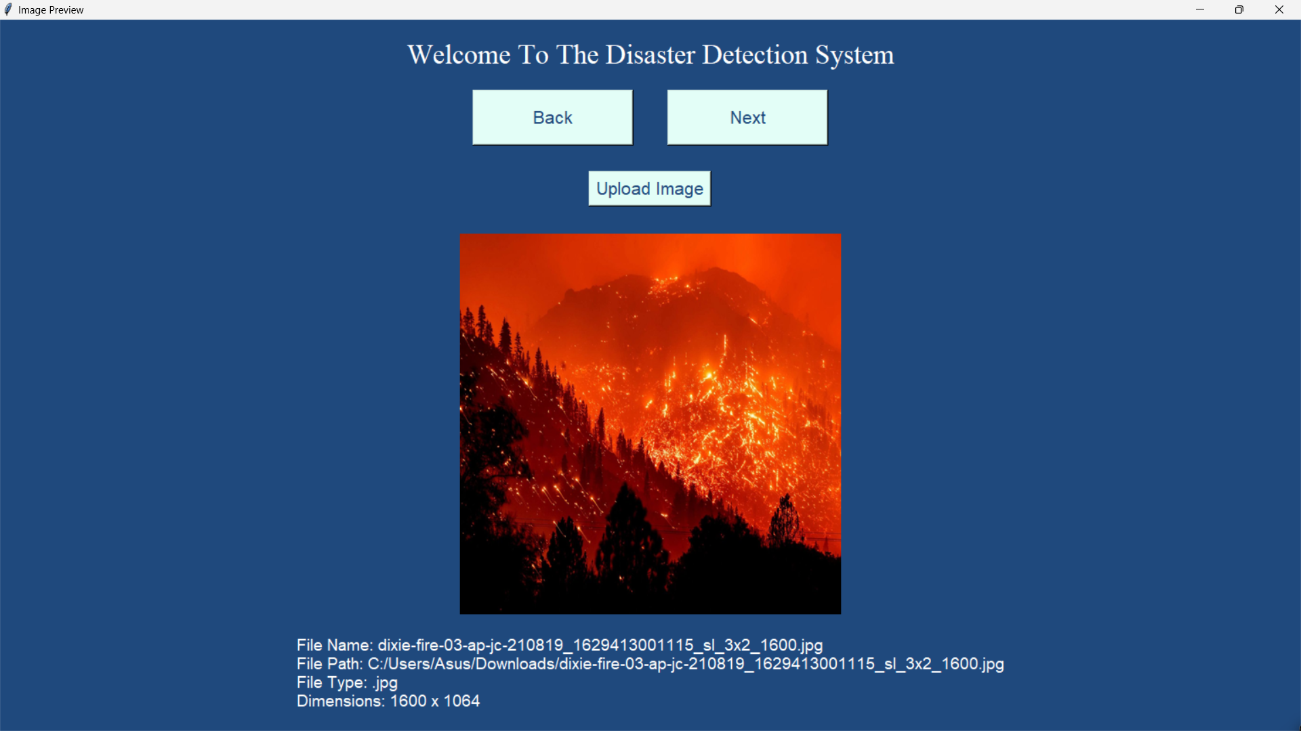

Slide 12


Slide 13


Slide 14
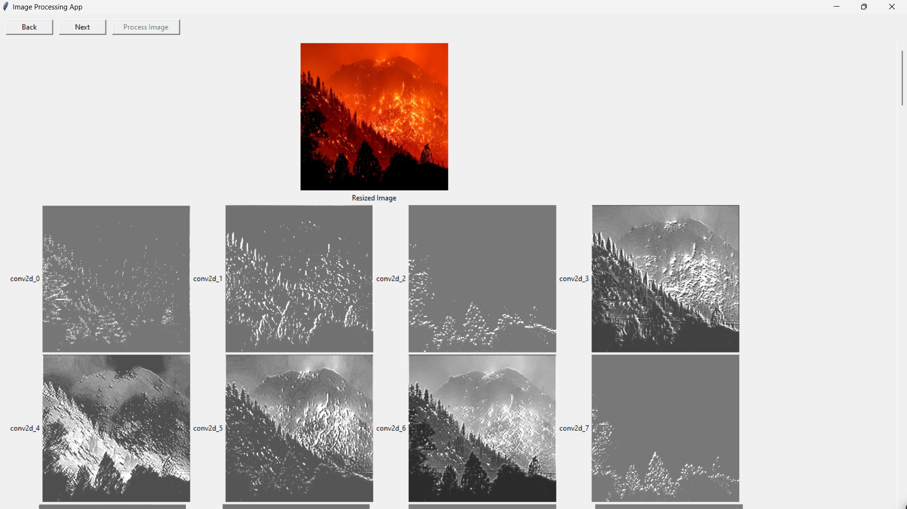

Slide 15
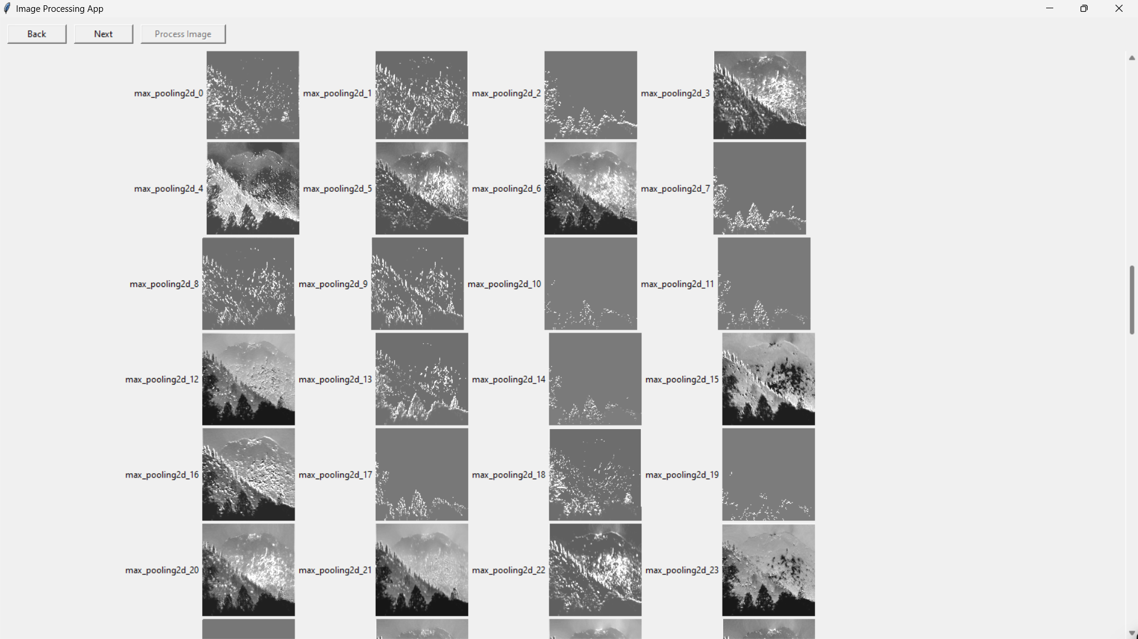

Slide 16
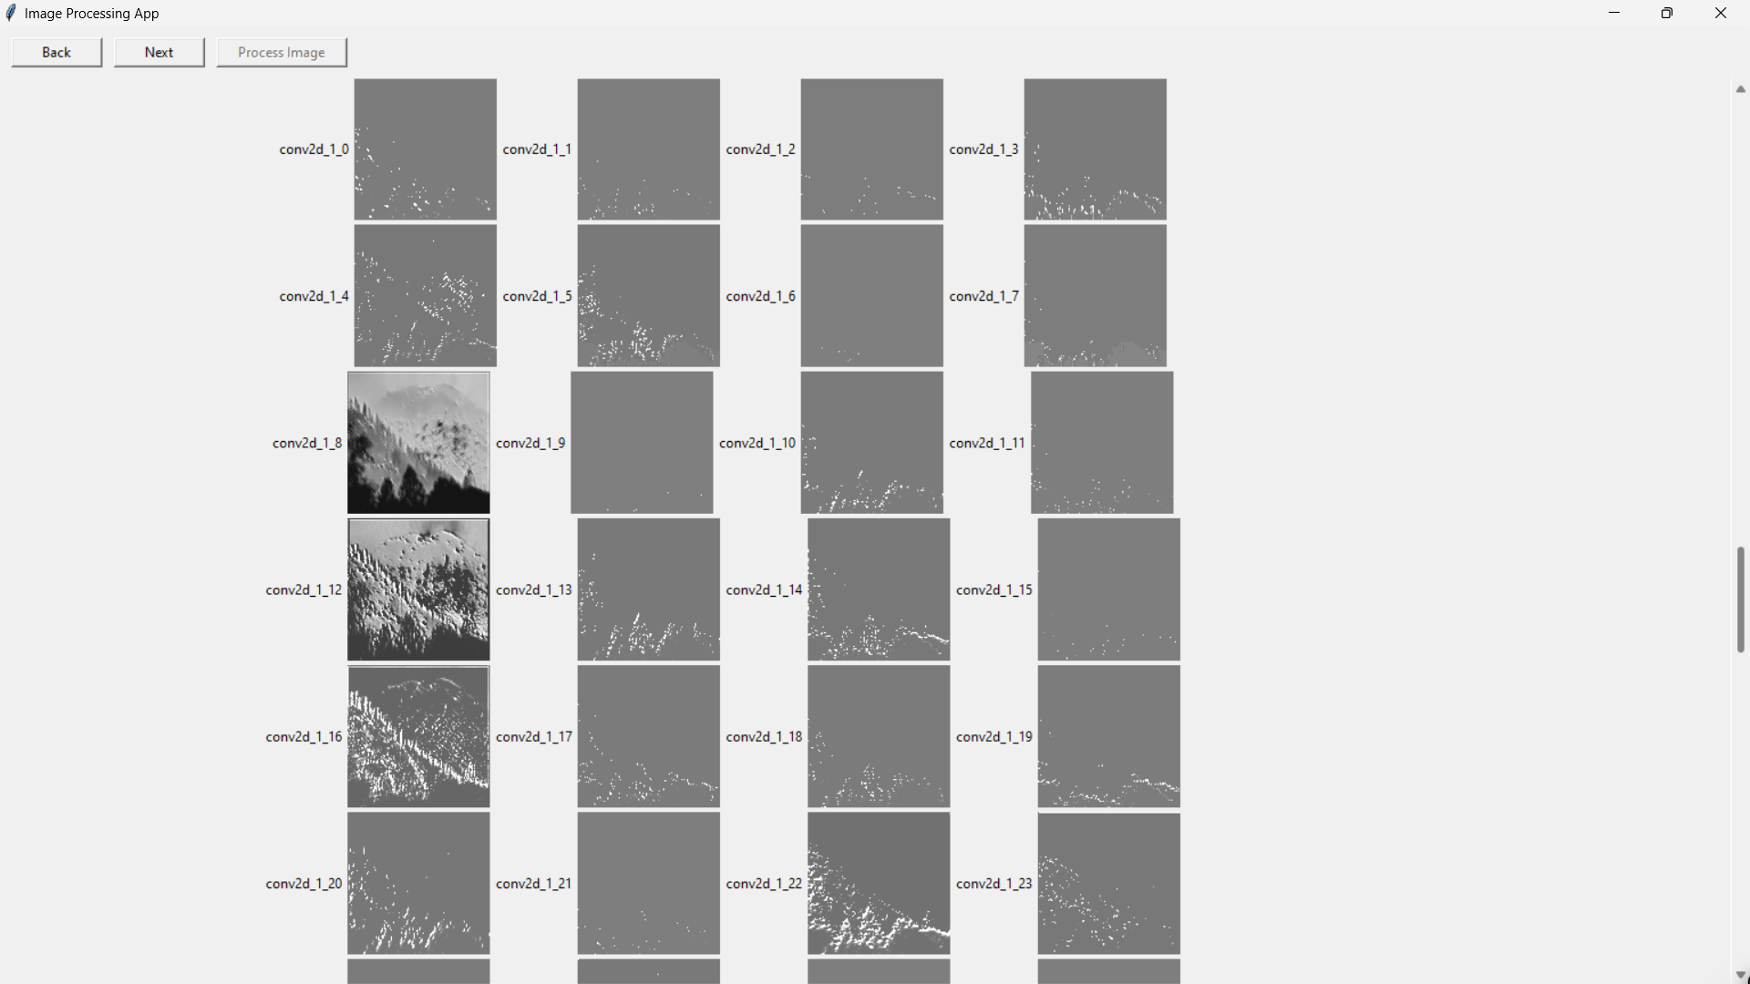

Slide 17


Slide 19
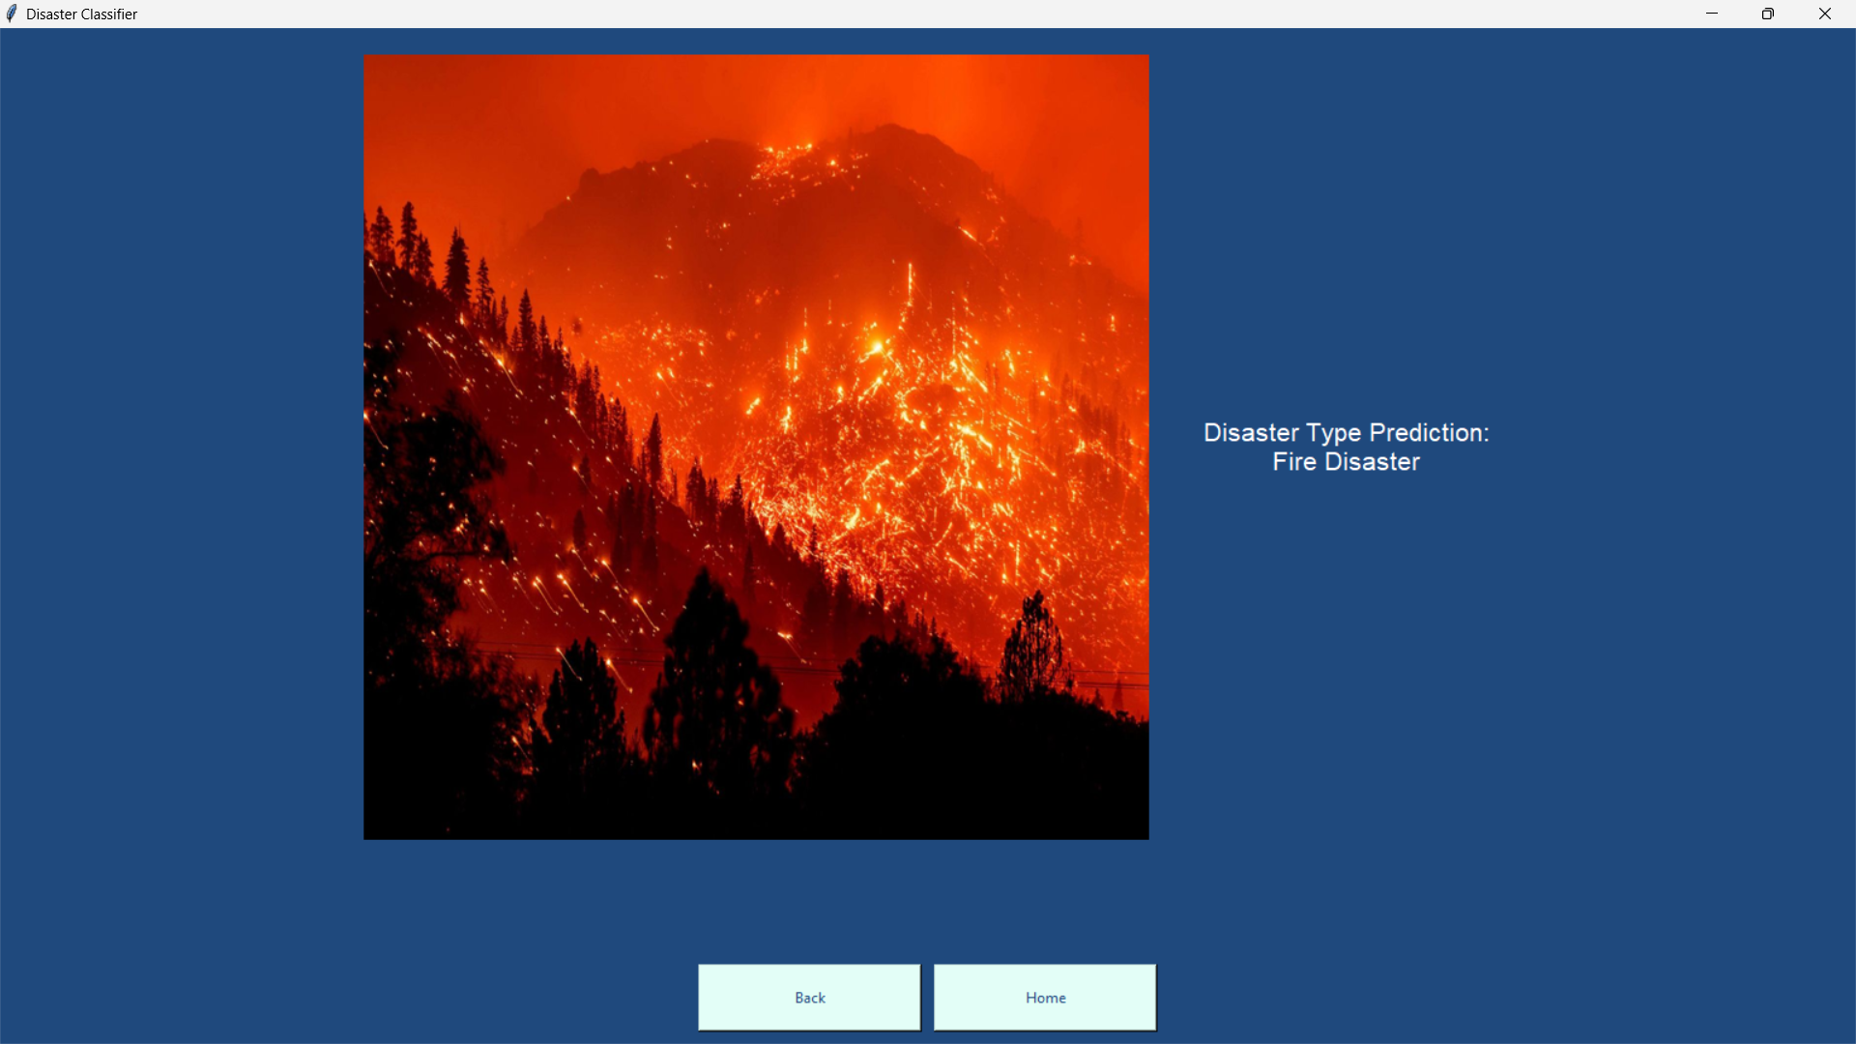

Slide 20

CONCLUSION
In conclusion, the Disaster Detection project represents a significant advancement in leveraging state-of-the-art technologies for effective monitoring and response to calamities. Through the integration of advanced models such as Convolutional Neural Networks (CNNs) categorizing images. The project's success lies in its adaptability to handle complex data patterns, overcome model drawbacks, and provide a comprehensive solution for disaster detection.

Slide 21

THANK YOU

